Slide 1
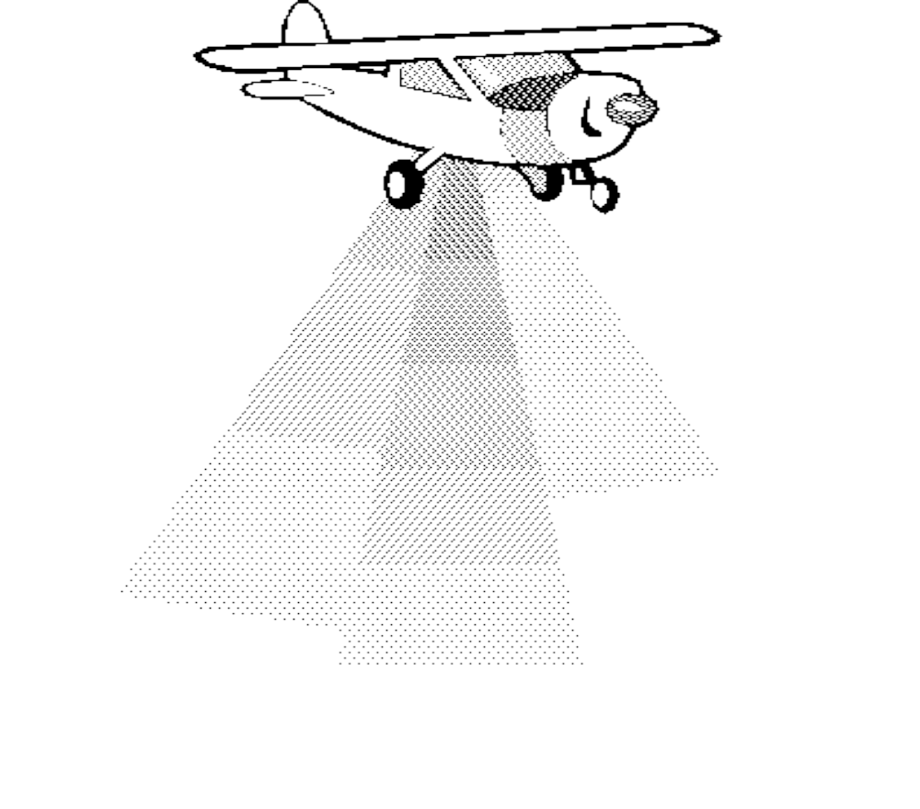

Welcome to Aerial Overview Surveys Training
1.1.1

Slide 2
Classroom Objectives
Review survey methodology
  Participant’s guide
  Video
  Examples
Demonstration & Practice
  Preparing for surveys
  Conducting surveys
  Completing surveys
1.2.1

Slide 3
Agenda
Day 1:
  Welcome
  Planning surveys
  Conducting surveys
  Completing surveys
LUNCH
  Case studies/demonstrations
  Day 2:
    Practice flights
1.2.2

Slide 4
Aerial Overview Surveys
Aerial Overview Surveys are…
Landscape level assessments of symptoms caused by forest “agents”
Conducted in fixed wing aircraft at low flight intensities
Recorded on satellite imagery maps at a scale of 1:100,000
Used to identify disturbances:
  trees attacked by bark beetles
  defoliated trees
  trees damaged by animals or abiotic factors
2.1.1

Slide 5
Overview vs. Operational Surveys
Aerial Overview Surveys:
  Broad level assessment of all pests from fixed wing
  Provide information on historical patterns
  Used to determine where to conduct operational surveys
Operational Surveys:
    Accurately map specific pest problems from helicopter
    Used for stand-level operations
2.1.2

Slide 6

Importance of Aerial Overview Surveys
Consistent
Cost Effective
Efficient
2.1.3

Slide 7
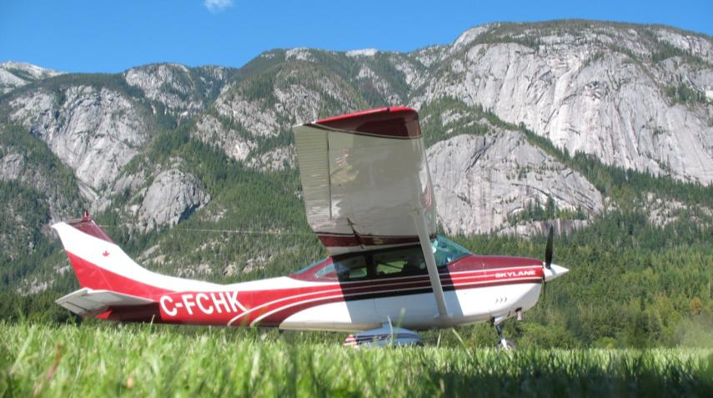
Key Uses of Aerial Overview Survey Data
Various management uses
Input into national inventories
Various research uses
Input into Timber Supply Analysis
2.1.4

Slide 8
Roles and Responsibilities for
Aerial Overview Surveys
MoFR general responsibility (since 1999)
Forest Health Initiatives Officer for Provincial co-ordination
Regional forest health specialists for administration of the surveys
Qualified MoFR personnel or consultants to conduct the survey
2.1.5

Slide 9
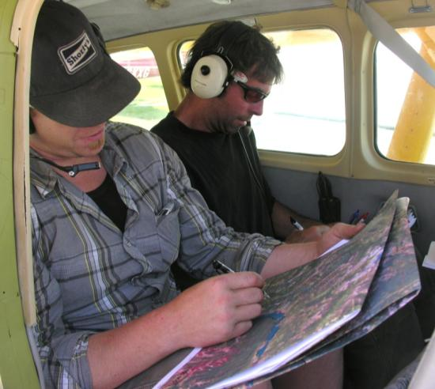
Characteristics of Survey Personnel
Comfortable mapping and navigating in the air for a maximum of 5 hours
Distinguish tree species from the air
Distinguish between red, green, yellow and grey
Familiar with pest biology, local terrain and weather
2.1.6

Slide 10

Timing of Aerial Overview Surveys
Bark Beetles
July 15 – Aug 31
Spruce Budworms
July 1 - 31
Dothistroma
July 1 - 31
Lophodermella
July 1 - 31
Aspen Defoliators
July 1 - 31
Western Hemlock Looper
Aug 15-31
Western Blackheaded Budworm
Aug 15-31
2.1.7

Slide 11
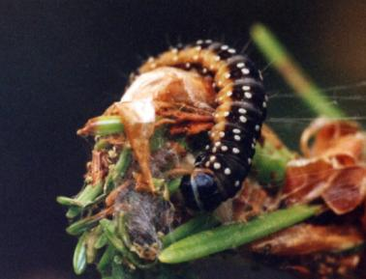
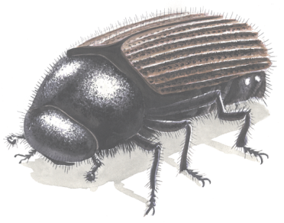
What is Surveyed?
All forested areas in the province
Identify forest health disturbances:
Bark beetles
Defoliators
Diseases
Abiotic factors
Animal damage
2.1.8

Slide 12
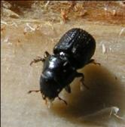
Major Bark Beetles of BC
Mountain pine beetle
Spruce beetle
Douglas-fir beetle
Western balsam bark beetle
2.1.9

Slide 13
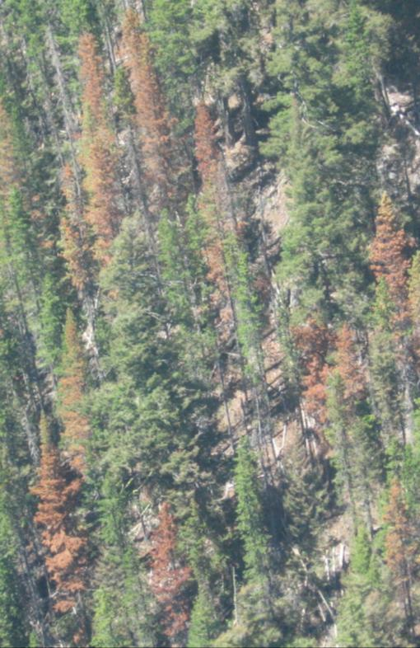
Foliage Symptoms of
Mountain Pine Beetle
1 year post attack:
Yellow, orange then bright red crown in spring following attack
2 years post attack:
Dull red foliage remains on the tree
3 years post attack:
Crown grey; little foliage remains
2.1.10

Slide 14
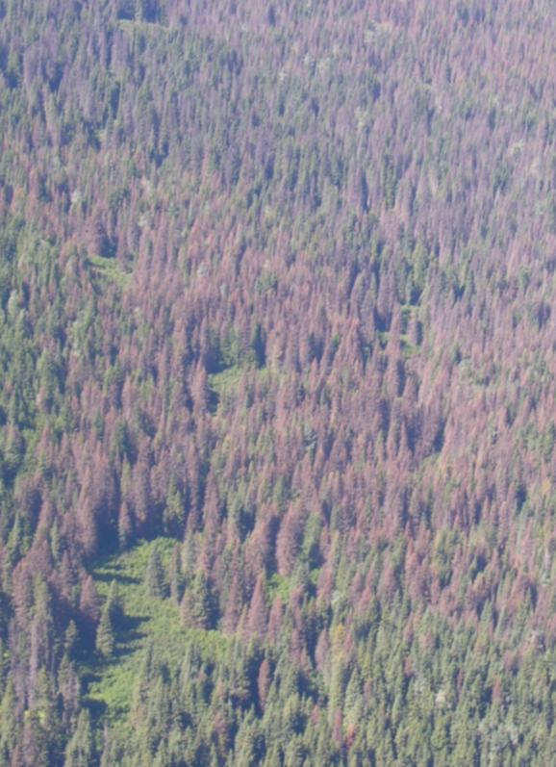
Foliage Symptoms of Spruce Beetle
1 year post attack:
No colour change in first spring following attack
2 years post attack:
Light yellow or purplish gray crowns after 18 to 30 months (may just go gray) – crowns die from bottom up
3 years post attack:
Grey crowns; needles drop
2.1.11

Slide 15
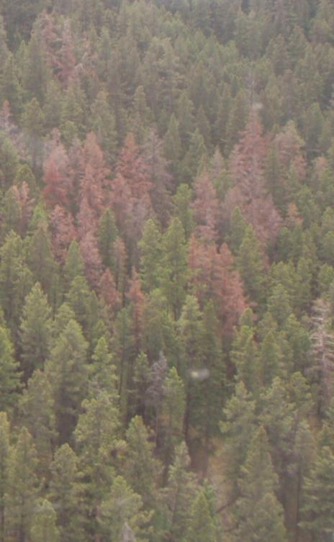
Foliage Symptoms of
Douglas-fir Beetle
1 year post attack:
Bright pinky-red crown in the spring following the attack; may turn faded red in year of attack
2 years post attack:
Crowns grey by spring
3 years post attack:
Crowns grey; little foliage remains
2.1.12

Slide 16
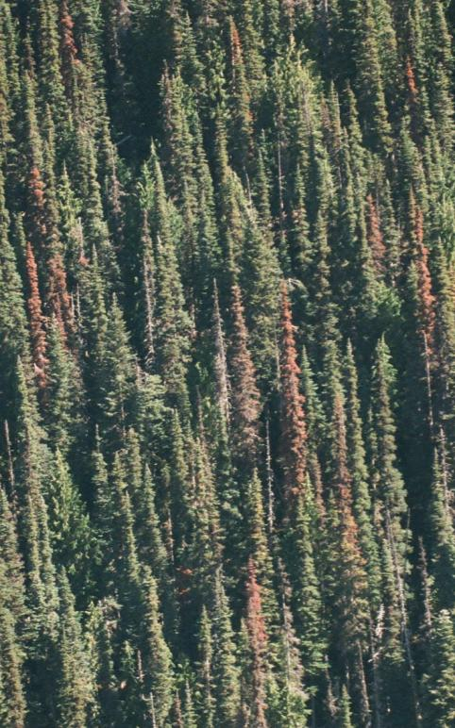
Foliage Symptoms of
Western Balsam Bark Beetle
1 year post attack:
Bright orange then bright red crown in spring following attack
2 years post attack:
Sill quite a red crown, may be mistaken for current attack
3 years post attack:
Dull red crown, may remain this way for up to 5 years
2.1.13

Slide 17
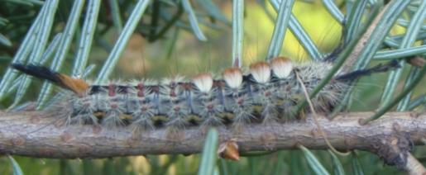
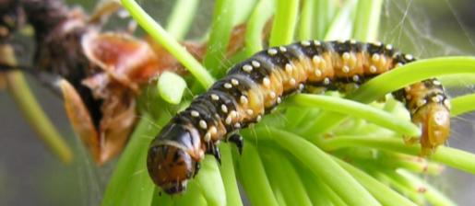
Common BC Forest Insect Defoliators
Aspen and poplar leaf and twig blight
Bruce spanworm
Dothistroma needle blight
Douglas fir tussock moth
Eastern spruce budworm
Forest tent caterpillar
Large aspen tortrix
Pine needle cast
Satin moth
Serpentine leafminer
Two-year cycle budworm
Western blackheaded budworm
Western hemlock looper
Western spruce budworm
2.1.14

Slide 18
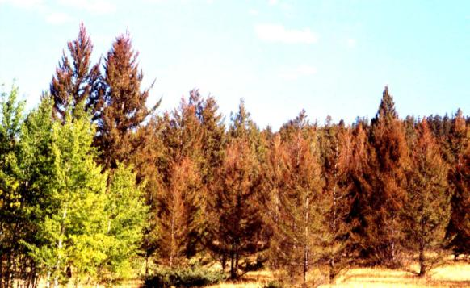
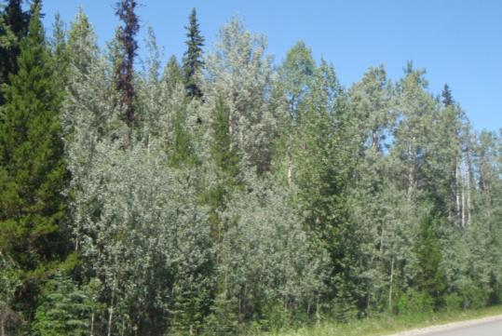
Defoliation Visual Characteristics
Affects all ages of host trees
Tends to be widespread
Short mapping window (rain, re-growth)
Coniferous stands turn reddish, purplish
Deciduous stands turn silver, grey or brownish
2.1.15

Slide 19
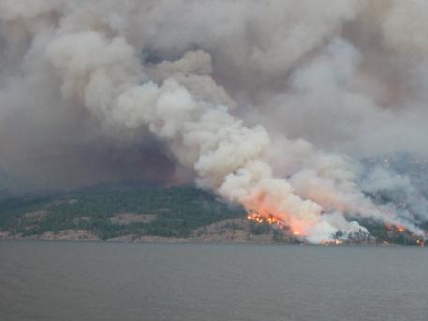
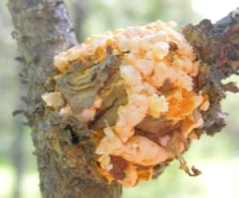
Other Damage Attributes
Blowdown and flooding
Effects of drought
Fire
Redbelt
Declines
Animal damage
Root diseases
Other forest health agents not visible during the survey
2.1.16

Slide 20
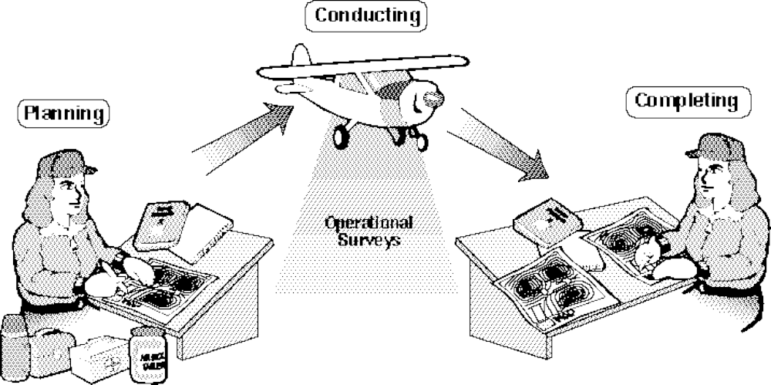
Aerial Overview Survey Phases
2.1.17

Slide 21

Planning Steps
Obtain satellite images of survey area
Familiarize yourself with local conditions
Request suitable aircraft
Ensure border consistency
Plan out flight lines
Collect required equipment
2.2.1

Slide 22
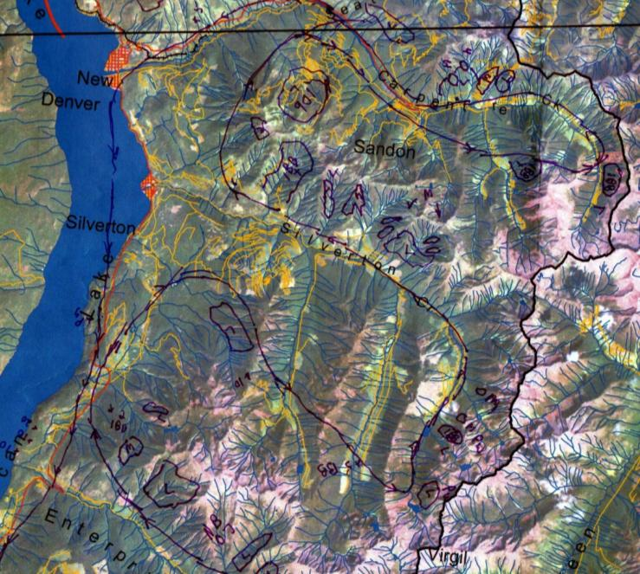
Satellite Images
Two copies &
mylar
1:100,000 scale
Add various TRIM layers
Digitize previous disturbances????
2.2.2

Slide 23
Local Conditions
Review historical pest information
Interview local sources
Familiarize yourself with anticipated pests
Consider recent weather impacts
Review the types of trees found in the area
2.2.3

Slide 24
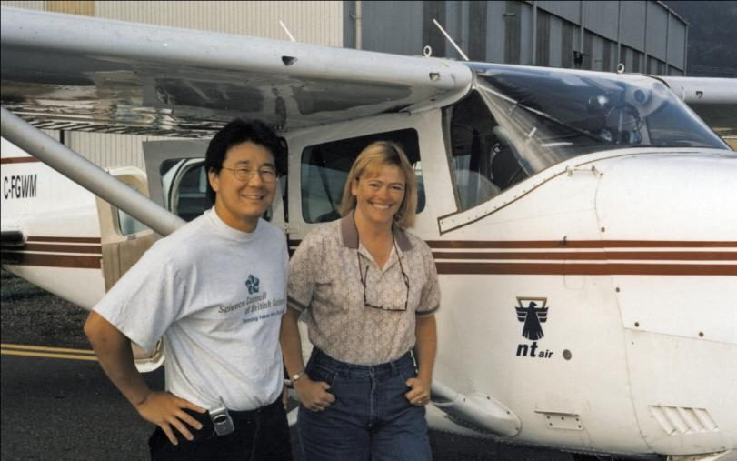
Aircraft Request
Check availability
Book through MoFR fire center
Be flexible
2.2.4

Slide 25

Aircraft Features
High wing configuration
Minimum seating capacity of four
Capable of flying 70-90 knots
Suitable for terrain
Pilot with local knowledge
2.2.5

Slide 26
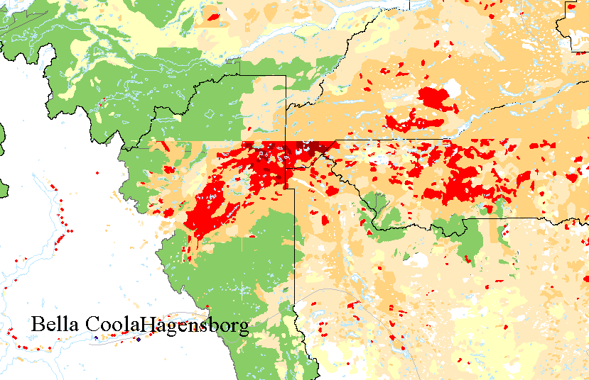
Border Consistency
2.2.6

Slide 27
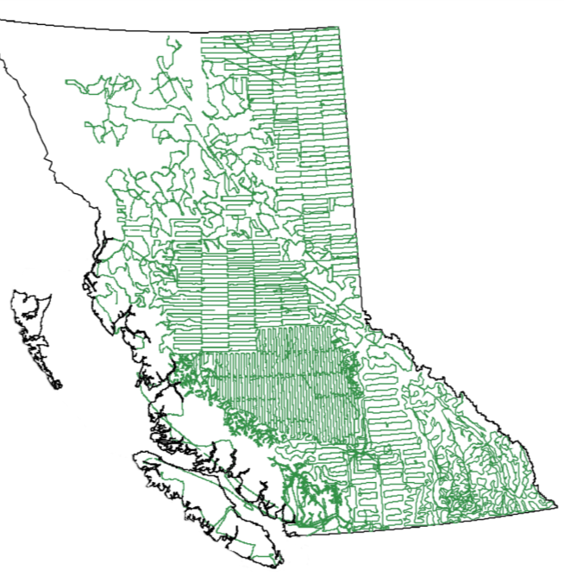
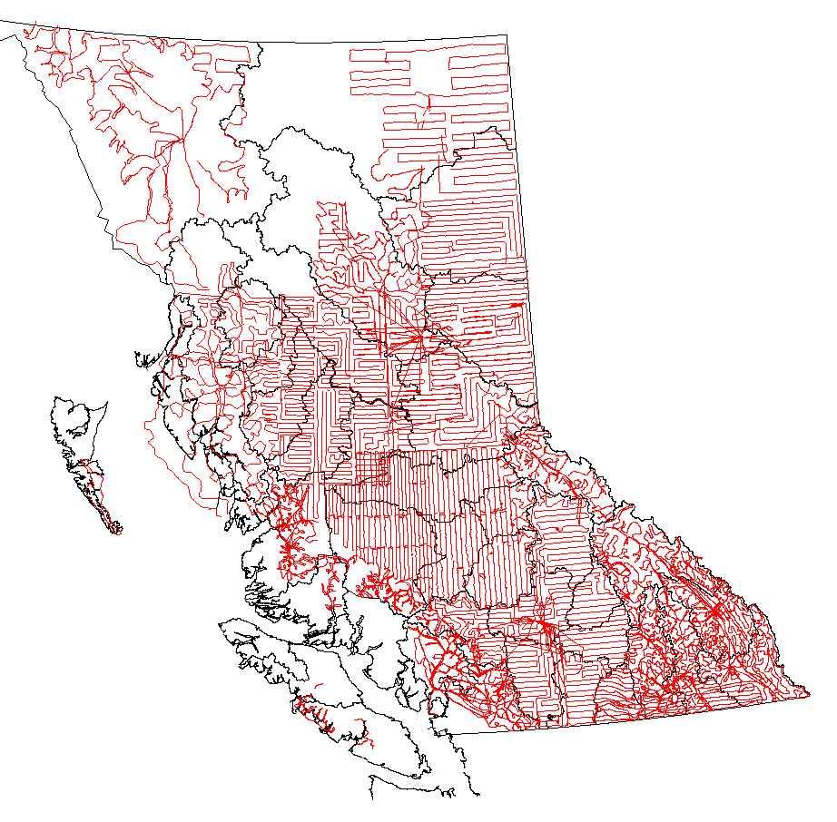
Plan Flight Lines
2004 lines
2009 lines
2.2.7

Slide 28
Survey Equipment
Supply of pens and pencils, ruler
Camera (SLR)
Tinted/polarized glasses
(Binoculars)
Motion sickness and sinus medication
Lunch
GPS unit
Appropriate clothing
Maps (lots)
2.2.8

Slide 29

Conducting Steps
Review flight plan with pilot
Follow safety instructions
Flight tips and techniques
Identify disturbances and map
2.3.1

Slide 30

Review Flight Plan
Re-fueling considerations
Weather considerations
Terrain
Flying height, speed and design
Where to put GPS unit
Proposed flight lines
2.3.2

Slide 31
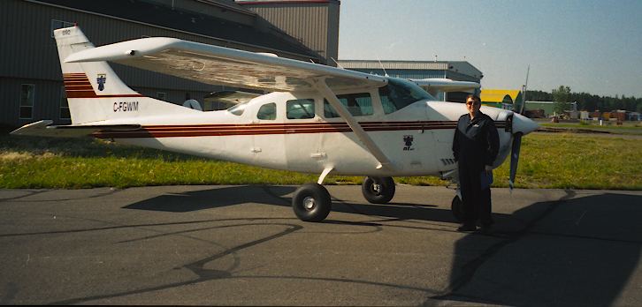
Safety Considerations
Follow pilot’s safety instructions
Never approach the propeller(s)
Communicate frequently with pilot
Check in with MoFR every 30 min
2.3.3

Slide 32
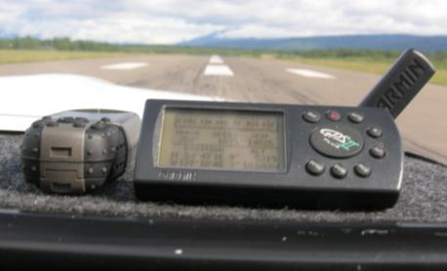
Flight Tips and Techniques
Ensure you are well rested
Be careful with food and drink
Obtain a daily weather forecast/check highway cams
Double check flight supplies
Conduct survey between 9:00am and 3:00pm maximum
Limit flight time to 5 hours
Schedule breaks
Prepare GPS unit
2.3.4

Slide 33
Identify and Map Disturbances
Mark disturbance on map as x or polygon
Rate intensity of damage
Identify type of disturbance
Identify host tree species
Identify stand type, if applicable
2.3.5

Slide 34
Attack Intensity Classes for Mapping Mortality
“X” for single trees from 1 to 50
“T” (trace) <1% of trees in polygon recently killed
“L” (light) 1-10% of trees in polygon recently killed
“M” (moderate) 11-29% of trees in polygon recently killed
“S” (severe) 30-49% of trees in polygon recently killed
“VS” (very severe) 50% + of trees in polygon recently killed
2.3.6

Slide 35
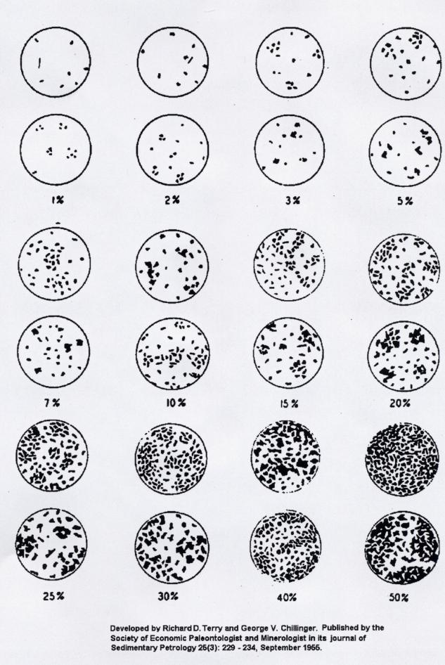
Estimating Mortality Intensity
2.3.7

Slide 36
Defoliator Intensity Ratings
Light (L)
Moderate (M)
Severe (S)
Grey (G)
Discoloured foliage barely visible
Pronounced discolouration, top 1/3rd of many trees defoliated
Bare branch tips, completely defoliated tops
Only recorded ONCE at end of outbreak for severe mortality patches
2.3.8

Slide 37
Damage Codes for Disturbances
 | A | Animal Damage |  | IB | Insect Bark Beetles
 | AB | Bear |  | IBB | Balsam bark beetle, Dryocoetes confusus
 | AP | Porcupine |  | IBD | Douglas-fir beetle, Dendroctonus pseudotsugae
 | AS | Squirrel |  | IBI | Engraver beetles, Ips spp.
 |  |  |  | IBM | Mountain pine beetle, Dendroctonus ponderosae
 | DF | Foliage Diseases |  | IBP | Twig beetle , Pityogenes, Pityophthorus spp.
 | DFB | Delphinella needle cast, Delphinella sp. |  | IBS | Spruce beetle, Dendroctonus rufipennis
 | DFL | Lophodermella needle cast, Lophodermella concolor |  | IBT | Red turpentine beetle, Dendroctonus valens
 | DFM | Larch needle cast, Meria laricis |  | IBW | Western pine beetle, Dendroctonus brevicomis
 | DFH | Larch needle blight Hypodermella laricis
 | DFS | Red band needle blight (Dothistroma), Mycosphaerella Scirrhia Y pini |  | ID | Insect Defoliators
 | DFT | Sirococcus tip blight, Sirococcus strobilinus |  | IAB | Balsam woolly adelgid, Adelges piceae
 | DLV | Aspen-poplar twig & leaf blight, Venturia spp. |  | IDB | 2-year-cycle budworm, Choristoneura biennis
 | PDT | Cedar leaf blight, Didymascella thujina |  | IDN | Birch leaf miner, Fenusa putilla
 |  |  |  | ID2 | Bruce spanworm, Operophtera brumata
 | DR | Root Disease |  | IDE | Eastern spruce budworm, Choristoneura fumiferana
 | DRA | Armillaria root disease, Armilaria ostoyae |  | IDF | Forest tent caterpillar, Malacosoma disstria
 | DRB | Black stain root disease, Leptographium wagneri |  | IDG | Green striped looper, Melanolophia imitata
 | DRL | Laminated root disease, Inonotus sulphurascens |  | IEB | Hemlock sawfly, Neodiprion tsugae
 |  |  |  | IDK | Northern tent caterpillar, Malacosoma californicum
 | DS | Stem Diseases |  | ID6 | Serpentine leaf miner, Phyllocnistis populiella
 | DSB | White pine blister rust, Cronartium ribicola |  | IDH | Western blackheaded budworm, Acleris gloverana
 | DSC | Comandra blister rust, Cronartium comandrae |  | IDL | Western hemlock looper, Lambdina fiscellaria lugubrosa
 |  |  |  | IDP | Larch sawfly, Pristiphora erichsoni
 | N | Abiotic Injuries |  | IDS | Conifer sawfly, Neodiprion sp.
 | NB | Fire |  | IDT | Douglas-fir tussock moth, Orgyia pseudotsugata
 | NCA | Aspen decline |  | IDU | Satin moth, Leucoma salicis
 | NCB | Birch decline |  | IDW | Western spruce budworm,Choristoneura occidentalis
 | NCY | Yellow cedar decline |  | IDX | Large aspen tortrix, Choristoneura conflictana
 | ND | Drought |  | IDZ | Western false hemlock looper, Nepytia freemani
 | NF | Flooding
 | NG | Frost
 | NH | Hail
 | NK | Fumekill
 | NN | road salt
 | NR | Redbelt
 | NS | Slide
 | NW | Windthrow
 | NY | Snow or Ice
2.3.9

Slide 38
Host tree species codes
A | Aspen |  | H | Hemlock
AC | Poplar |  | HM | Mountain hemlock
ACB | Balsam poplar |  | HW | Western hemlock
ACT | Black cottonwood
AT | Trembling aspen |  | L | Larch
AX | Hybrid poplars |  | LA | Alpine larch
 |  |  | LW | Western larch
B | Fir (Balsam)
BA | Amabilis fir |  | P | Pine
BB | Balsam fir |  | PA | Whitebark pine
BG | Grand fir |  | PL | Lodgepole pine
BL | Subalpine fir |  | PW | Western white pine
 |  |  | PY | Ponderosa pine
C | Cedar
CW | Western redcedar |  | S | Spruce
YC | Yellow cedar |  | SB | Black spruce
 |  |  | SW | White spruce
E | Birch |  | SS | Sitka spruce
 |  |  | SX | Spruce hybrid
FD | Douglas-fir
2.3.10

Slide 39
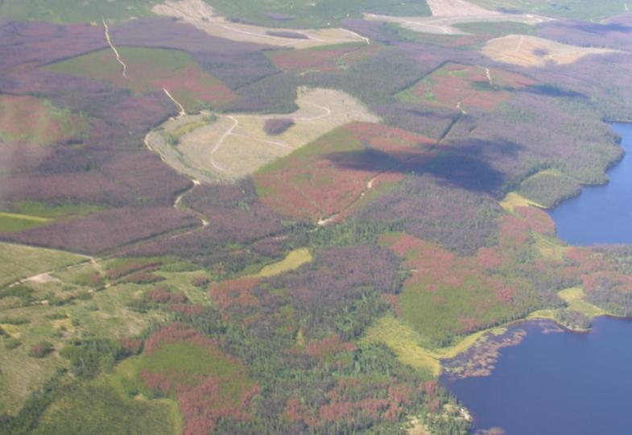
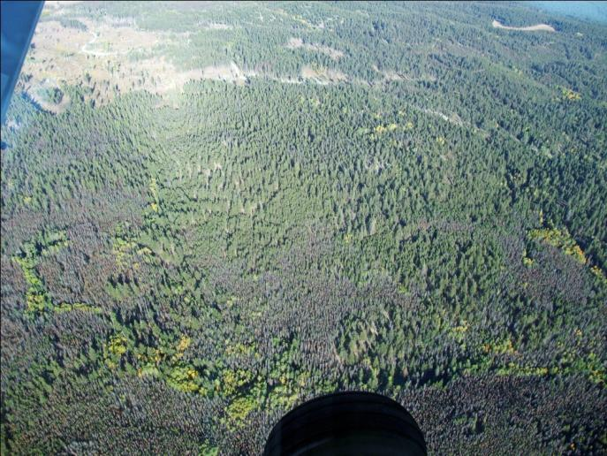
Stand Modifiers for Mountain Pine Beetle Attack
“Y” = young stand
“US” = understory
2.3.11

Slide 40
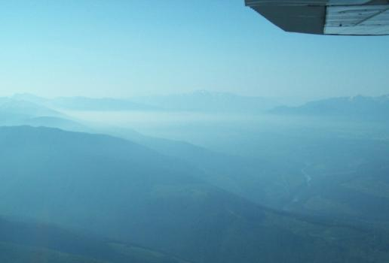
Mapping tips
Map to smallest level of detail possible
Avoid mapping with sun in your eyes
Weather choices:
  Best: sunny
  Next best: even cloud cover
  Poor: mix of sun and cloud
  Unacceptable: rain or heavy smoke/haze
2.3.12

Slide 41
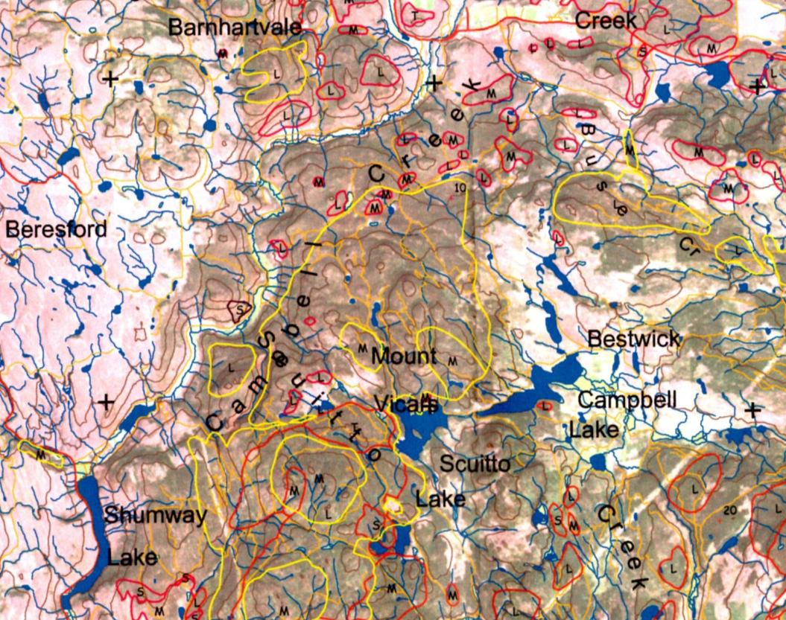
Survey Map
2.3.13

Slide 42
Completing Steps
Review and clarify maps
Download GPS track files
Conduct ground confirmations
Transfer data to clean map
Weekly reporting requirements
Digitize final data
2.4.1

Slide 43
Review Maps
Review for legibility and meaning
Compare among observers
Identify areas to visit
Justify large changes
2.4.2

Slide 44
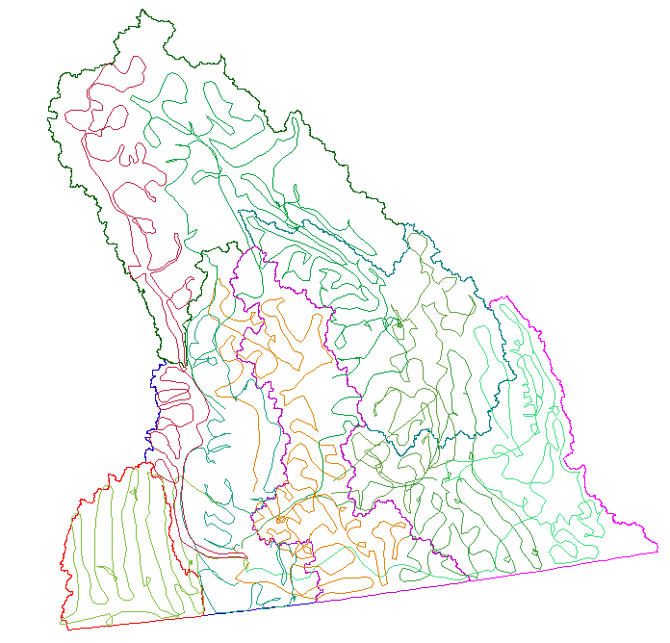
GPS Tracks
Download with Ozi Explorer
Compare to hand drawn
Export into ArcView shape files
2.4.3

Slide 45

Ground Checks
Play detective – check pictures, pest histories, local experts etc.
If necessary, visit site and look for signs of the damage agent
Revise map
2.4.4

Slide 46
Transfer Data
Do final composite mylar ASAP
No previous year’s information
Large disturbances and N/A areas
Compare/match to adjacent sheets and adjacent surveyors
Good quality
Add a legend
2.4.5

Slide 47
Weekly Reporting
Track files for the week
Maps flown
Maps digitized (if applicable)
Weather comments or other issues
Log of hours flown
2.4.6

Slide 48
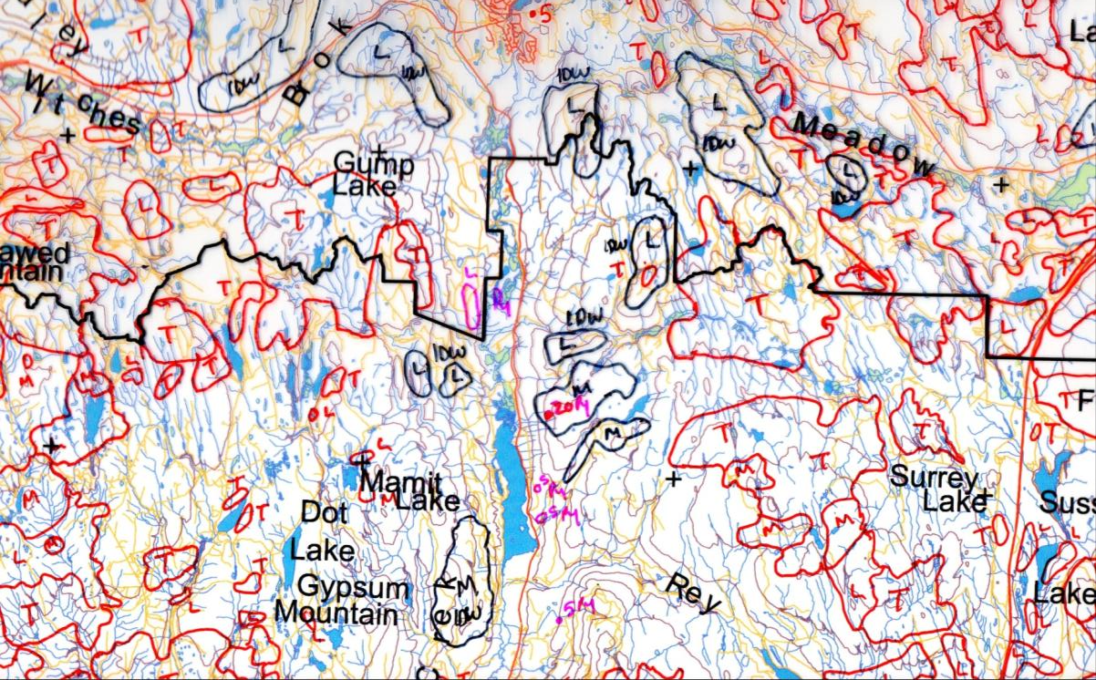
Final Mylar Example
2.4.7

Slide 49
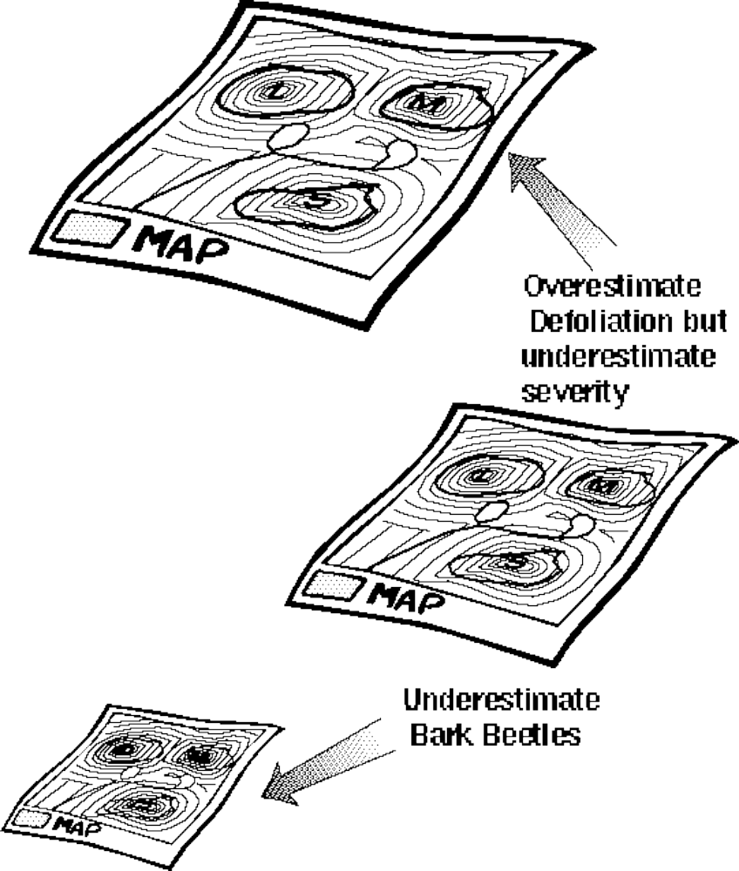
Accuracy of the Surveys
2.5.1

Slide 50
Survey Limitations
Older damage is not included
Poor estimator of volume
Cannot add disturbances cumulatively
Not all pest damage is aerially visible
It can still be a quality product that is the building block of all forest health activities!!
2.5.2

